Slide 1
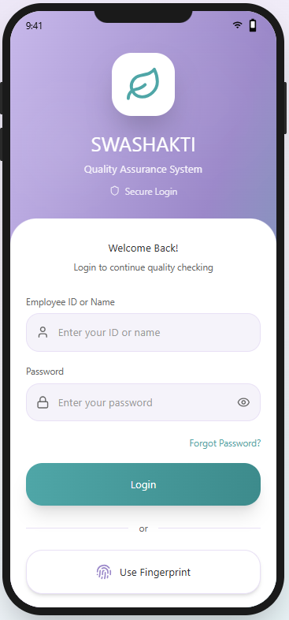
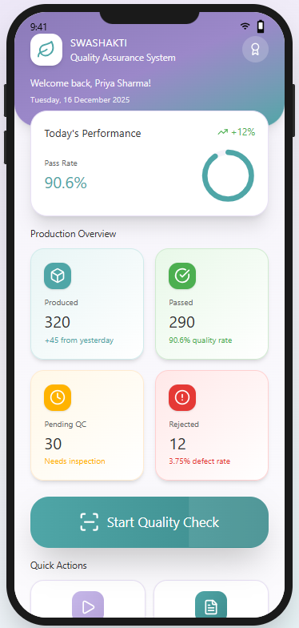
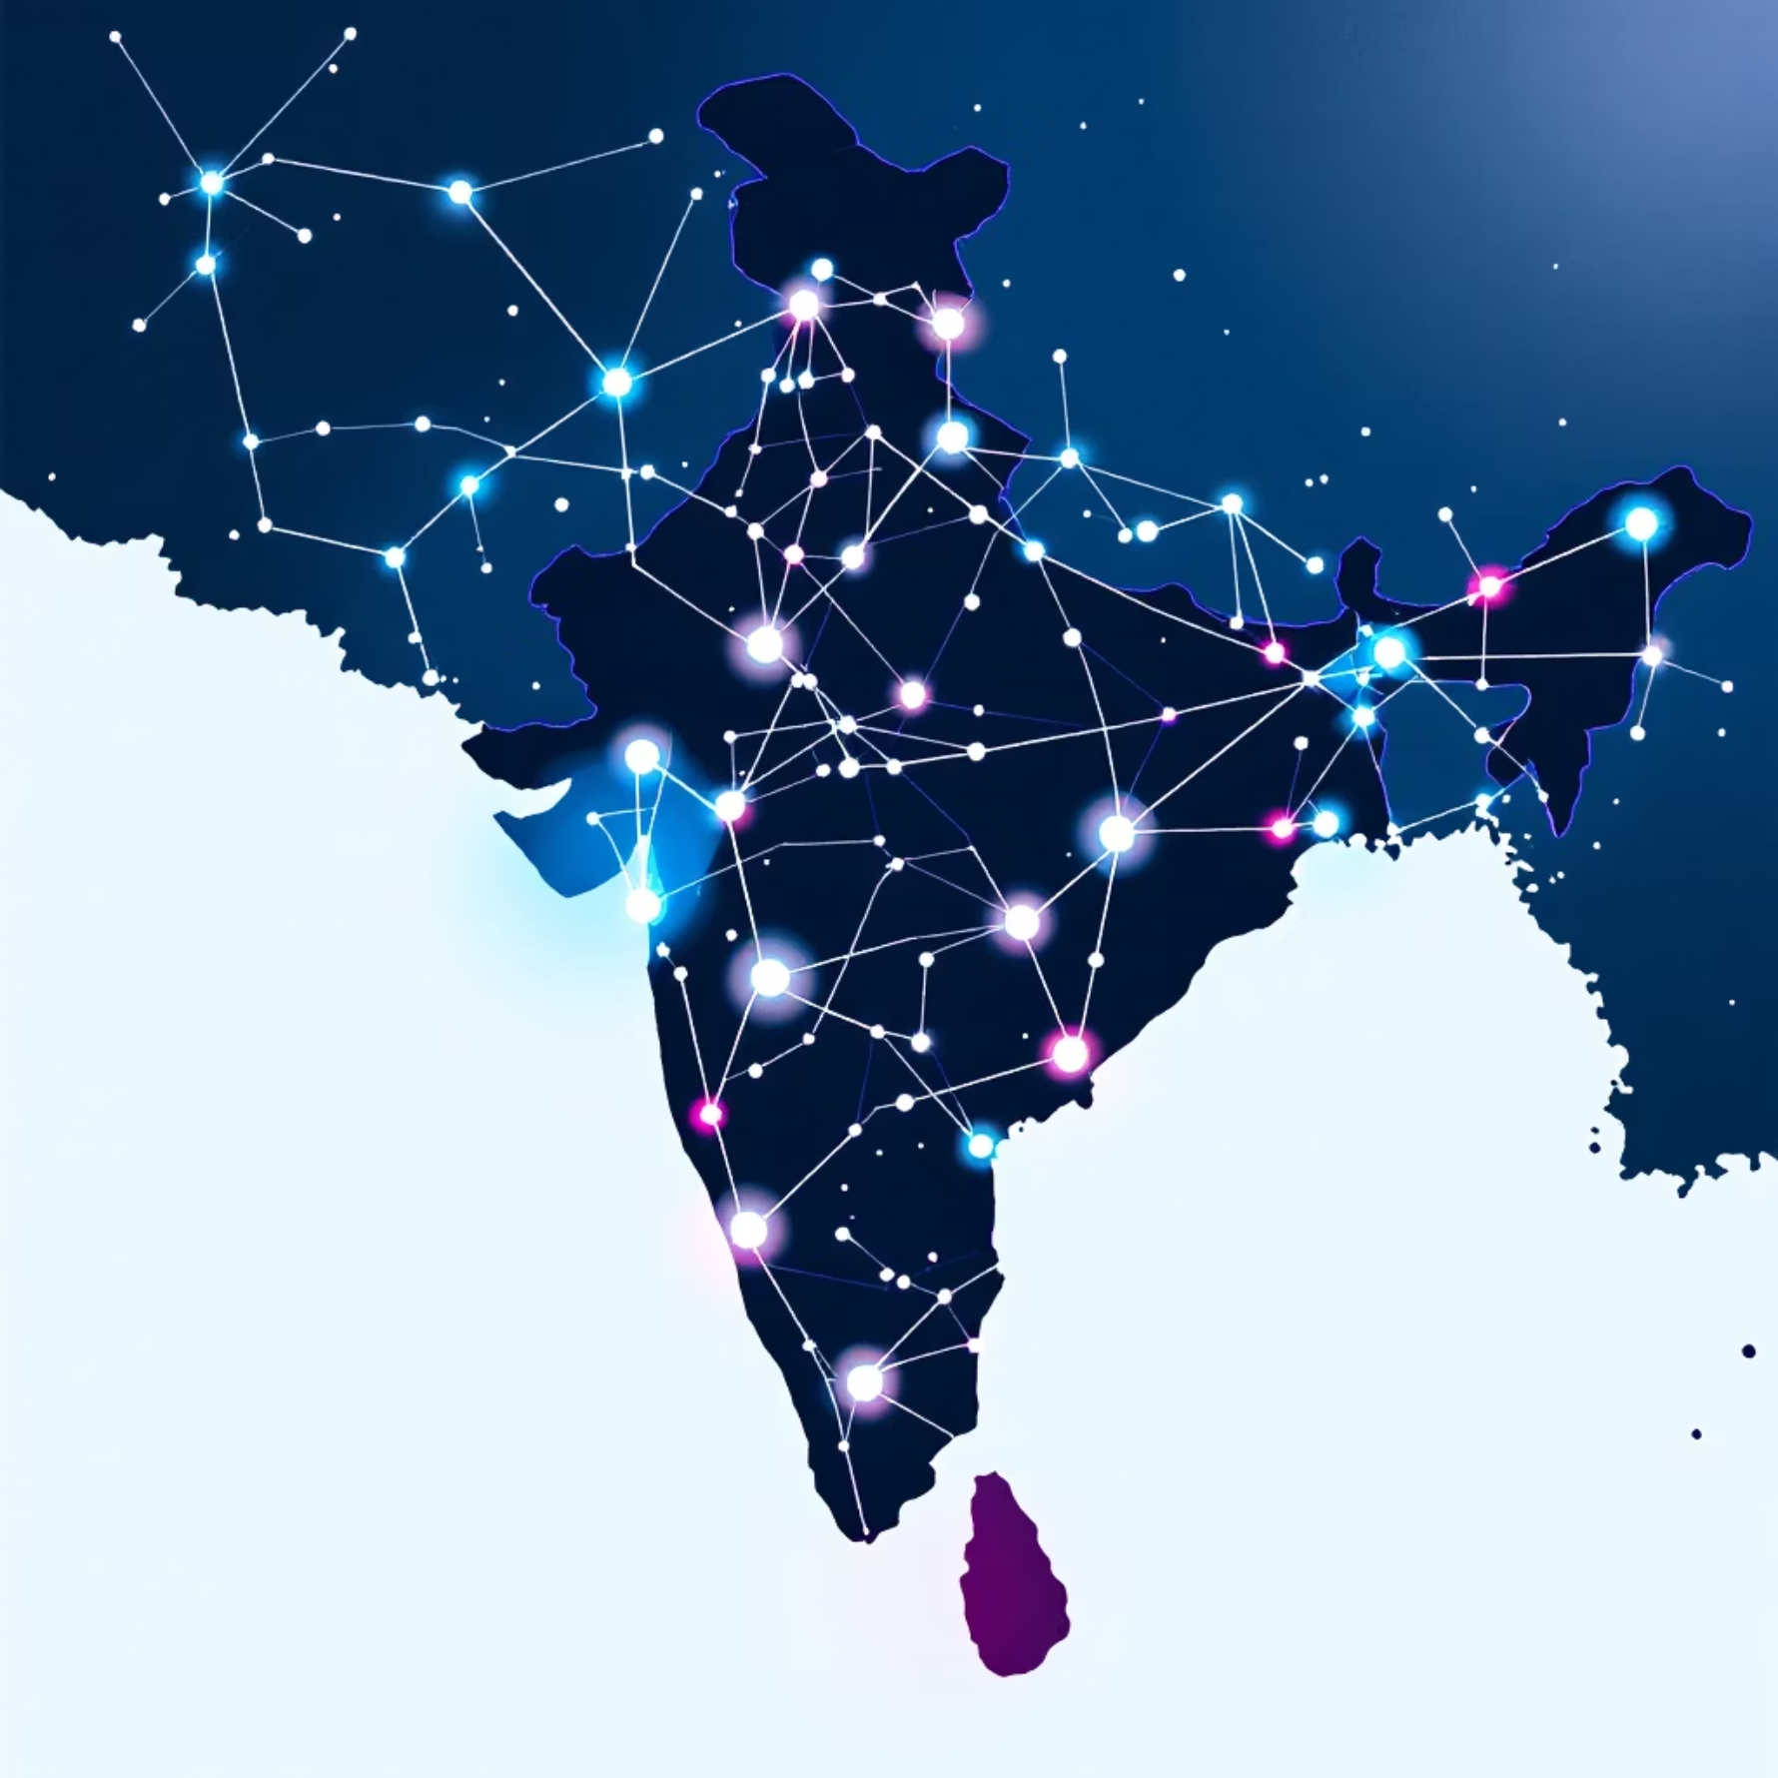
SWASHAKTI: Women-Led Hygienic &
Sustainable Pad Micro-Enterprise
Theme: Livelihood Generation & Women-Led Enterprises
The Problem & Opportunity
The Problem
Opportunity
Over 60% of rural women lack access to hygienic menstrual products, leading to serious health risks.
Unsafe menstrual practices contribute to infections and increased absenteeism from school and work.
A critical shortage of stable income opportunities hinders economic independence for many women.
Commercially available pads are often expensive and contribute to non-biodegradable waste.
Rural markets suffer from weak and unreliable distribution networks, limiting access to essential goods.
India presents a fertile ground for change with:
Rapidly rising digital adoption even in remote areas.
A robust ecosystem of Self-Help Groups (SHGs) ready for engagement.
Growing demand for affordable, eco-friendly menstrual products.
Strong government initiatives supporting women-led micro-enterprises.

Slide 2



Our Solution: SWASHAKTI
A Women-Run Micro-Enterprise Network
A decentralized model empowering trained women to create BIS-standardized, biodegradable sanitary pads using locally sourced materials.
Local Production
AI Quality Check
Eco-Friendly Tech
Small units (5-15 women) drive community-level manufacturing.
Innovative app for real-time quality assurance (sealing, size, contamination).
Utilizing sustainable materials like banana fiber and bamboo pulp.
Marketplace & Subscriptions
Education & Awareness
Diverse sales channels: direct, bulk, and recurring subscriptions.
Promoting menstrual hygiene education within local communities.
Why It Works
✔ Ultra-low cost ✔ Local ownership ✔ High social acceptability ✔ Environment-friendly ✔ Scalable micro-franchise model

Slide 3
Business Model: Feasible + Sustainable
Revenue Streams
Cost Structure
Product Sales: Biodegradable pads, panty liners, and comprehensive hygiene kits.
Procurement of sustainable raw materials.
Extensive training and skill development programs for women artisans.
Bulk Orders: Partnerships with schools, anganwadis (rural child care centers), NGOs, and CSR initiatives.
Regular machine maintenance to ensure continuous production.
Subscription Model: Affordable ₹49/month hygiene kits specifically for school girls.
Eco-friendly packaging design and production.
SWASHAKTI Franchise Kit: Includes machinery, raw materials, branding, and comprehensive training.
Ongoing app development and maintenance for quality control, alongside establishing quality labs.
Digital Marketplace Commission: A 10% fee on all online sales generated through our platform.
Financial Feasibility
Break-even in 5–6 months per unit
Profit margin per pad: 20–30%
Monthly income for women: ₹6,000–₹12,000

Slide 4


Scalability Strategy
Our phased approach ensures sustainable growth and widespread impact.
Phase 1: Pilot
Phase 3: National Scale
Phase 2: Expansion
50 women trained; 3 units established
10,000 women; 200 units; wide distribution
500 women; 15 production units
01
02
03
Phase 1: Pilot (1 District)
Phase 2: Expansion (10 Districts)
Phase 3: National Scale
50 women undergo comprehensive training.
Launch of a centralized digital marketplace.
Expansion to 200+ production units across India.
Establishment of 3 initial production units.
Rollout of the micro-franchise model.
Impacting over 500,000 women directly and indirectly.
Targeting 10,000 pads/month production capacity.
Strategic partnerships with NGOs, SHGs, and CSR programs.
Product diversification to include baby diapers, cloth pads, and wellness products.
Why It Scales
Simple, low-tech production process for easy replication.
High market demand ensures sustained growth.
Deep community acceptance fosters local ownership.
Portable micro-franchise model enables rapid deployment.
BIS standardization builds crucial consumer trust.

Slide 5

Expected Social Impact
SWASHAKTI is designed to create a ripple effect, transforming lives and communities.
Women Empowerment
Stable income for 500+ women in Year 1.
Development of leadership, digital, and financial literacy skills.
Creation of sustainable, women-owned community enterprises.
Health Impact
Promotion of safer and more hygienic menstrual practices.
Projected 30% reduction in menstrual infection rates.
Significant increase in school attendance for adolescent girls.
Environmental Impact
Production of 100% biodegradable sanitary pads.
Reduction of 15–20 tons of plastic waste annually.
Implementation of compost-based disposal and a pad buy-back program.
Economic Impact
Significant boost to the rural economy through local production and sales.
Creation of new, sustainable job opportunities within communities.
Establishment of a resilient, community-driven value chain.

Slide 6
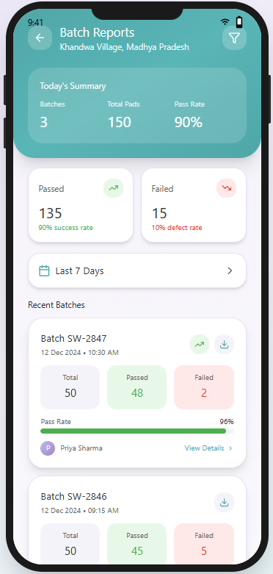
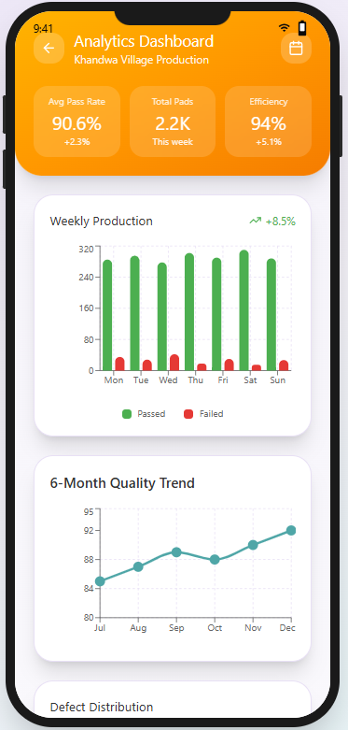
Prototype / Model Overview
Our robust prototype encompasses all critical elements for successful deployment.
Biodegradable Sanitary Pad
AI Quality Check App
Branding & Packaging
Low-cost, high-quality, meeting BIS standards.
Ensuring consistent product excellence.
Attractive, informative, and sustainable.
Micro-Unit Layout Map
Awareness Program Toolkit
Optimized for efficient local production.
Comprehensive materials for community education.
Validation Metrics
User Feedback
Collected from students and rural women to ensure product acceptance and suitability.
Cost Efficiency
Comparative analysis of cost per pad against major branded competitors.
Absorbency Test
Rigorous testing according to BIS 5405 standards for performance.
Quality Consistency
Monitored through continuous AI-assisted app checks to maintain standards.

Slide 7
Why SWASHAKTI Will Work
Community-First Approach
Driven by women, for women, ensuring inclusivity and local relevance.
Triple Bottom Line Impact
Simultaneously addresses hygiene, livelihood, and environmental goals.
BIS Standardisation
Ensures product credibility and consumer trust through certified quality.
Strong Partnership Readiness
Leveraging existing networks like SHGs, ASHA workers, and CSR initiatives.
Proven Market Demand
A clear need for affordable, accessible, and hygienic menstrual products in rural areas.
Replicable & Adaptable
Simple model designed for easy replication across diverse states and regions.
National Alignment
Directly supports key national priorities such as Digital India, Women-Led Development, Swachh Bharat, and Startup India.

